Slide 1

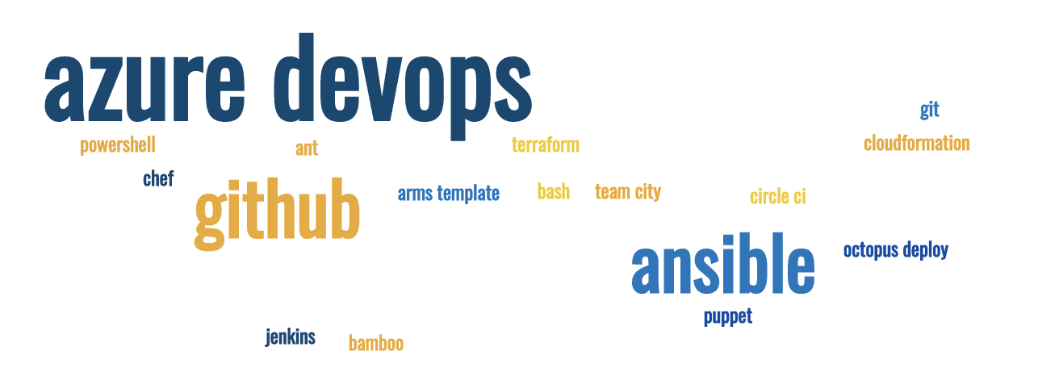
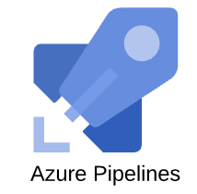
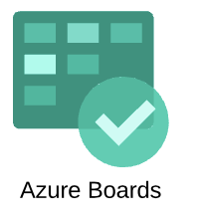
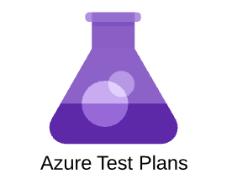
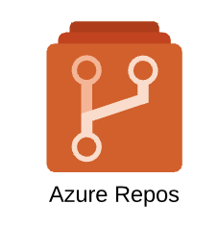
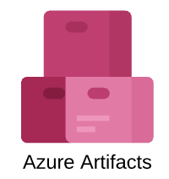
Azure – Pipelines
brew install --cask powershell
CI/CD (Continuous Integration and Continuous Deployment) लगातार टेस्टिंग और लगातार रिलीज़
Sujit Singh

Slide 2
Agenda
Azure DevOps – Pipelines
Quick Recap
Pipelines
Release (Classic)
Automation - Demo
Break and quiz …
Library
KeyVaults
Custom tasks

Slide 3
Azure DevOps – recap
Free account
Azure Boards,
Azure Repos
Azure Pipeline
Azure Artifacts
Dashboards, Wiki etc

Slide 4
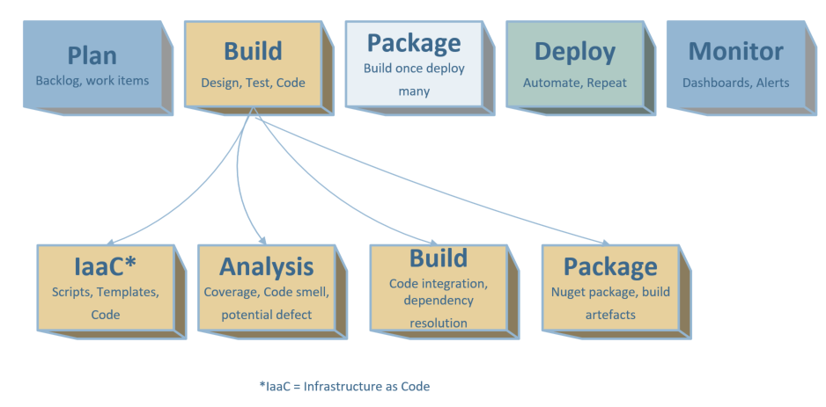
Azure DevOps - Build
Notes:
CI – Not the integration testing. Purely code integration to ring fence bad check ins, highlight code quality and missing tests etc early in the sprint.
Infrastructure as a Code
On-going code analysis and report. Zero tolerance for new code

Slide 5
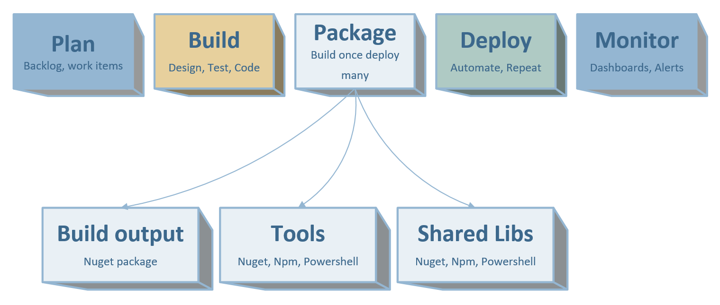
Azure DevOps - Package

Slide 6
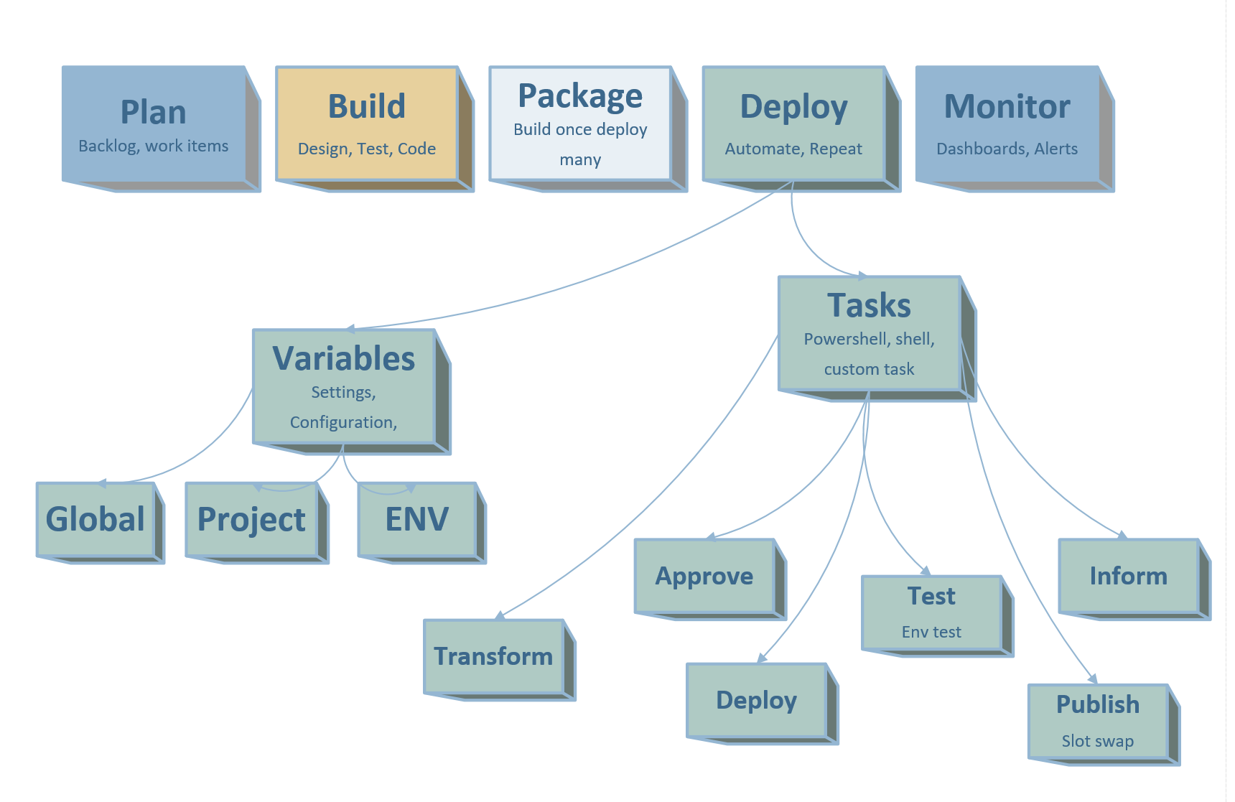
Azure DevOps - Deploy

Slide 7
Azure DevOps - Package
Plan
Pipelines
Monitor
DAST
Compile
Unit Test
Packaging
SAST
Security Test
Report Publish
Analysis
Transformation
Acceptance Test

Slide 8
Demo

Slide 9
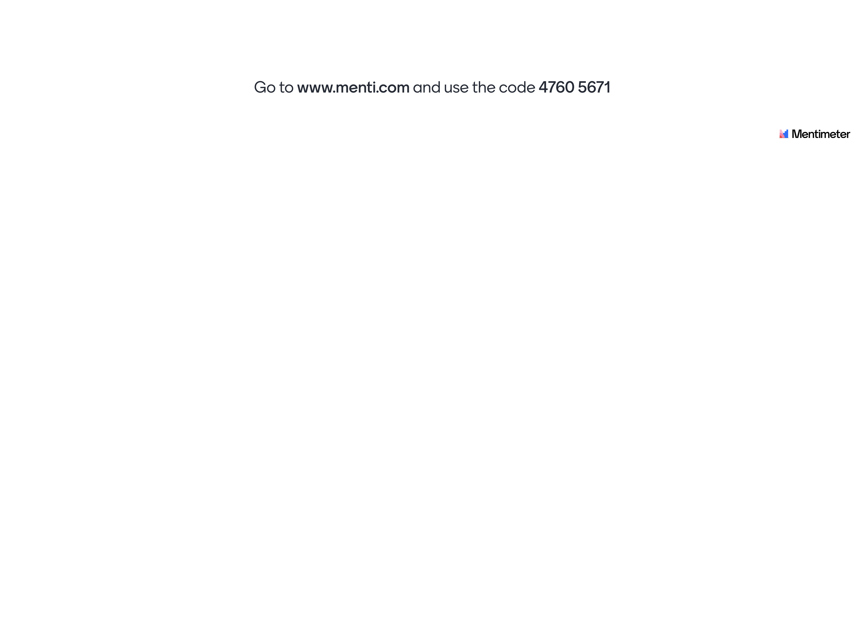
Break and quiz

Slide 10
Azure Boards – Pipelines
Originally it used to be Build
Renamed to Pipelines for change in licensing
Agents
Hosted
Self Hosted
Resources
Virtual Machines
AKS resources
Build and deploy to stages (aka multi-stage pipelines)
Refined triggers
Branch specific model

Slide 11
Customization
Custom Task
Custom tools
Network specific agents

Slide 12
Questions?

